Slide 1
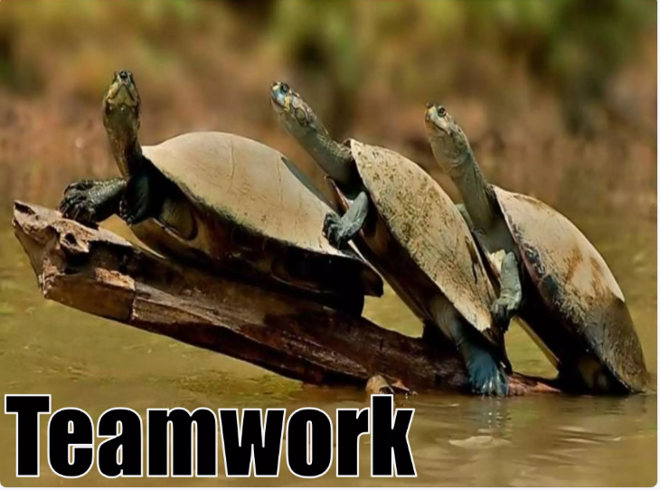

Slide 2
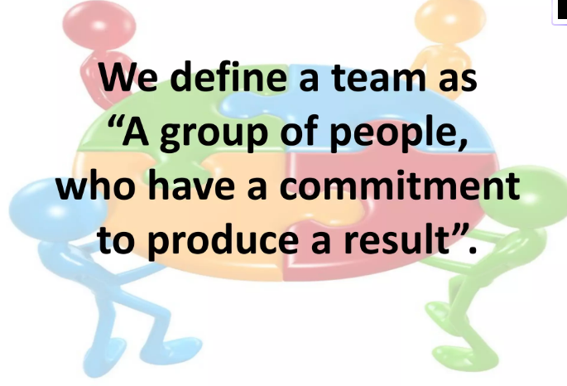

Slide 3
Teamwork
The ability to work together as a team is extremely valuable in every workplace. Teamwork involves many other interpersonal skills like communication, active listening, flexibility and responsibility. Those who are good ‘team players’ are often given important tasks in the workplace and may be seen as good candidates for promotions.

Slide 4
What is Team Work?
Teamwork is the process of working collaboratively with a group of people to achieve a common goal. It involves communication, coordination, and mutual support.

Slide 5
Teamwork is the collaborative effort of a group to achieve a common goal, where individuals contribute their unique skills, knowledge, and perspectives to accomplish a task more effectively than they could alone. It involves cooperation, communication, mutual support, and trust among members to foster a synergistic outcome where the collective effort is greater than the sum of its parts.

Slide 6
Key Elements of Teamwork
Common Goal:
A shared objective or purpose that all team members are working to achieve.
Collaboration:
The act of working together, sharing ideas, and providing mutual assistance to reach the goal.
Diverse Skills & Perspectives:
Leveraging the varied strengths, knowledge, and experiences of each individual member.

Slide 7
Key Elements of Teamwork
Communication:
Open and effective communication to ensure everyone is aligned and informed.
Mutual Support:
A supportive environment where members encourage and help one another, fostering trust and a positive atmosphere.
Synergy:
The combined output of the team is greater than what individuals could achieve on their own.

Slide 8
6 types of teams
1. Functional teams
Functional teams include members of the same department. When working within these teams, you share different responsibilities requiring communication and trust. Functional teams have leaders or supervisors to whom members report and who designate responsibilities. This type of team may be beneficial for contributing to and prioritizing workplace culture.
2. Cross-functional teams
Cross-functional teams share similarities with functional teams, with the primary difference being that members come from various departments. These teams are helpful for projects that require different expertise and viewpoints and often work best when supervisors and team leaders prioritize communication. Leaders typically delegate responsibilities to members based on their skill sets.

Slide 9
3. Self-managed teams
Self-managed teams are autonomous and don't require the same supervision as other teams because they share leadership and responsibilities. When engaging in a self-managed team, you may find providing constructive feedback to team members helpful. Startup companies and small businesses often use self-managed teams.
4. Troubleshooting teams
When issues arise within an organization, troubleshooting teams find solutions. Their goal is to improve processes for organizations. These teams require strong communication skills to resolve complex obstacles. They make recommendations to affected departments, who then implement them.

Slide 10
5. Project team
Project teams work on specific projects for their employers. Members typically come from several departments and perform tasks depending on their abilities. These teams have project leaders who assign responsibilities and monitor work.
6. Task-force teams
Organizations use task-force teams when emergencies arise. These teams comprise the most efficient members within an organization. Members work exclusively on their tasks within the team rather than combining a member's regular workload with the task force. The goal of the task force is to complete projects quickly and efficiently.

Slide 11
Why Teamwork Matters
Increased Efficiency:
Tasks are completed faster and more efficiently when individuals combine their efforts and strengths.
Improved Outcomes:
Diverse perspectives lead to innovative ideas, better problem-solving, and higher-quality results.
Skill Development:
Team members learn from each other, gain valuable work experience, and develop essential professional skills.
Enhanced Creativity:
A collaborative environment encourages creativity and allows challenges to be tackled from multiple angles.
Greater Productivity:
Teamwork often leads to increased productivity and allows a group to accomplish more than its individual members could alone.

Slide 12
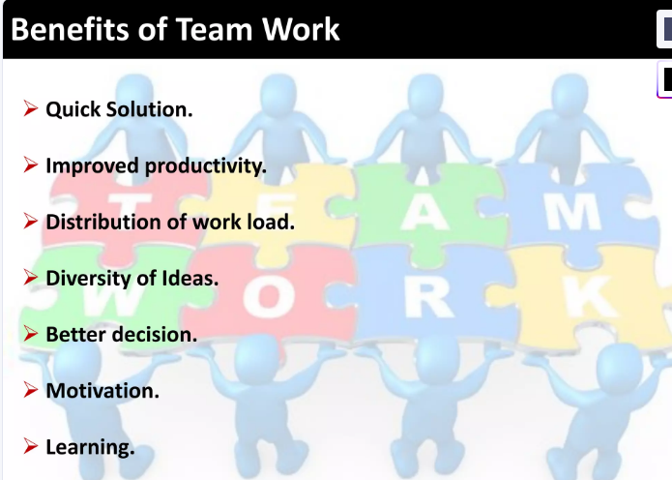

Slide 13
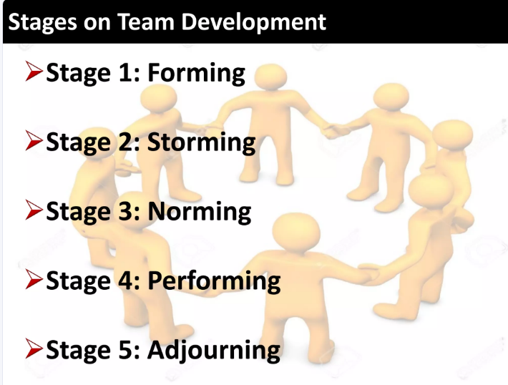

Slide 14
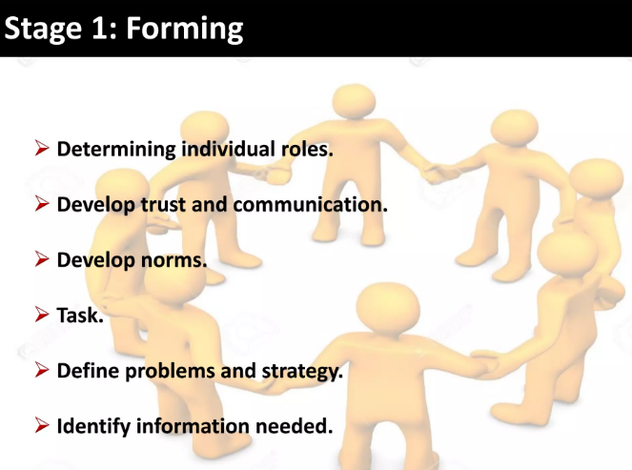

Slide 15
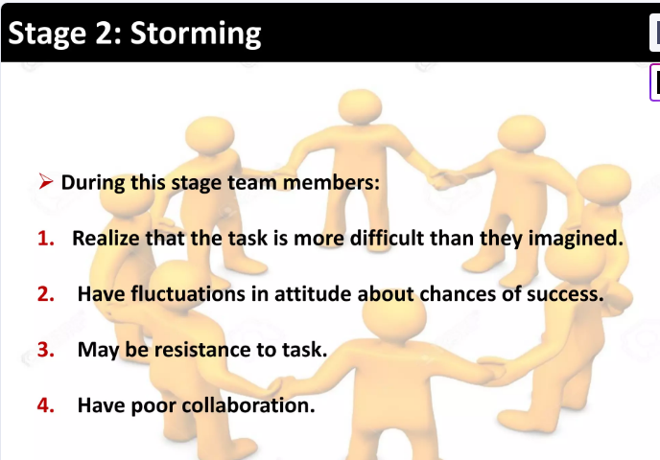

Slide 16
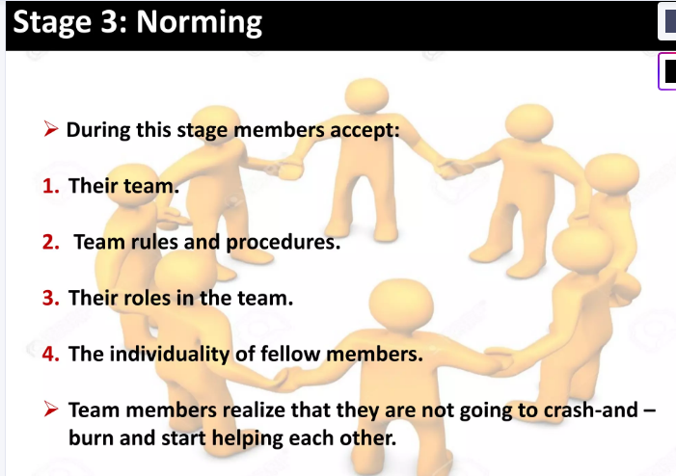

Slide 17
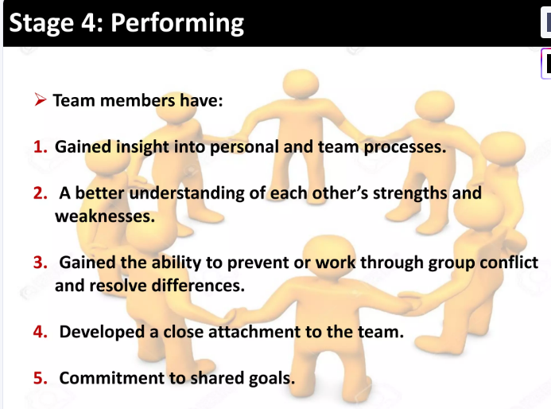

Slide 18
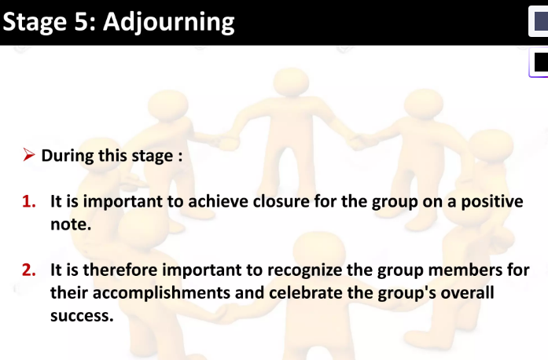

Slide 19
Characteristics of effective teamwork
Good communication between team members
Strong communication skills are important in many workplace scenarios, and they are directly related to how well one can work in a team environment. Being able to communicate maturely and respectfully can help build relationships between team members. Clear and effective communication is also vital for team leaders to adequately convey to team members what their roles and responsibilities include, while also communicating deadlines and milestones effectively.A lack of clear communication can cause confusion and disjointed teamwork, which prevents progress towards team objectives. This could involve efforts being duplicated if team members don't have a clear idea of responsibilities and tasks. For example, if a team leader issues a series of tasks without appropriately communicating how team members are to split up the tasks, some tasks may be duplicated, while others are left pending or incomplete as the project moves forward. Overall, this may lead to poor team morale and dissatisfaction.

Slide 20
Mutual respect for others
A respectful environment fosters goodwill and cooperation between people working together as a team. Some teams comprise people with different abilities and skill sets. A team that can understand and respect their personal differences provides the best possible environment for people to thrive and use their unique skills to benefit the team. Teams that accept others easily and treat one another respectfully and fairly help encourage positive and open communication.For example, taking the time to make a new team member feel welcome and included is an example of good teamwork. The new team member may be able to relax and might feel more comfortable about sharing new and innovative ideas with their new team. This may also benefit the team as a whole, as the new member can offer a different and refreshing perspective on the project.

Slide 21
Feeling comfortable speaking freely
In order to perform at their best, it's important that everyone in a team feels comfortable expressing their ideas. This can only happen if they know that the team treats everyone fairly and that team members can listen and compromise. People with strong teamwork skills know that their ideas may not always be the best and may be open to taking advice, guidance and solutions from other people if it means that the team moves further towards their goal. In an effective team, participants at all levels of seniority feel comfortable expressing their ideas without fear of undue criticism.

Slide 22
Co-operation and conflict resolution between team members
Conflicts and disagreements can still happen, even in the most supportive and collaborative team. When they do happen, a successful team can diffuse the tensions by addressing the problems head-on and finding a mutually agreeable solution. This might involve openly discussing problems and finding diplomatic approaches, such as a voting system, to decide between competing solutions.

Slide 23
Encouraging equal participation
A good team understands the skills that each team member brings and recognises how best to utilise these skills to work towards the team's ultimate goal. This works best when all team members take responsibility for inclusion and work closely together. In the best-case scenario, the team wants to encourage and support individuals to involve themselves in the ongoing work and play to their strengths. Strong leadership is also important to inspire this in a team.

Slide 24
Mutual support and positive attitudes
A team that supports each other, with team members wanting each other to succeed and do well, is likely to be more successful than one in which team members are excessively competitive or passive-aggressive. Good teamwork means that personal interactions between members are free from micro-aggressions, discrimination and other unpleasant speech that might make colleagues feel uncomfortable or upset. It's important for team members to handle disagreements calmly and respectfully.

Slide 25
Shared values and common goals
Shared values are an important part of a team's ethos. Having common values helps a team to work together and put aside any differences as they work towards a goal they all want to achieve. The fact that they are ultimately all aiming for the same thing creates a connection that reinforces a sense of teamwork and cooperation. It helps each team member to feel they are part of something bigger and they may feel more resilient than if they were working alone.

Slide 26
Benefits of teamwork in the workplace
1. Teamwork cultivates effective communication
Effective teamwork in the workplace starts with solid communication. In order to work together—whether when ideating or working on a new project—you need to communicate to create cohesion and clear goals.
2. Teamwork improves brainstorming
Brainstorming is a powerful method that helps teams think outside of the box. It involves individuals working together by communicating ideas for a number of initiatives. These could include projects, processes, products, and services.

Slide 27
3. Teamwork encourages a common goal
Having a common goal in mind is essential when it comes to prioritizing projects and new initiatives. With multiple team members working on individual tasks, a project goal helps keep deliverables aligned and ensures objectives are met.
4. Teamwork in the workplace improves problem solving skills
Problems can be difficult to solve on your own. That’s why working together as a team can offer quicker and often more effective solutions.

Slide 28
5. Teamwork helps build trust
Trust in the workplace is something that is built over time. It takes transparent communication, one-on-one sessions, and support to build that trust with team members.
6. Teamwork improves company culture
Most companies strive for a good organizational culture, but it’s not as easy as having chats at the water cooler or a monthly pizza party. Company culture involves making your team members feel heard and empowered to do their best work while offering them work-life balance and an overall enjoyable work environment.

Slide 29
7. Teamwork creates efficiency
From communicating effectively to improving company culture, teamwork drives many benefits, including creating team efficiency. An efficient team works together to quickly manage problems and daily tasks. As a result, efficient teams use resources more effectively and reach their deliverables faster. When it comes to organizational growth, few strategies are as impactful as cultivating streamlined efficiency through teamwork in the workplace. Such cohesion is instrumental in fostering innovative solutions while maintaining consistent quality.

Slide 30
8. Teamwork increases employee engagement
A little known secret to fostering long-term happiness and engagement is to nurture teamwork in the workplace. When team members feel part of a supportive group, they're more likely to be content and involved, which naturally boosts their work satisfaction over time.
To increase employee engagement, encourage teamwork inside and outside of work. Schedule time for your team to connect about more than just work. Your team will feel more open when working in a group, which leads to a higher retention rate.

Slide 31
9. Teamwork motivates high performing teams
Accountability is a powerful motivator, and teamwork in the workplace is a surefire way to instill this sense of responsibility. It spurs team members not just to meet expectations, but to exceed them and willingly contribute their best ideas to the group's endeavors. The higher performing each team member is, the higher performing your overall team will be, meaning you can create high quality work more efficiently. Not only is a high performing team good for your company, but it also helps job satisfaction, as doing well will motivate individuals to continue growing their skillset.

Slide 32
10. Teamwork in the workplace develops individual strengths
Teamwork isn’t just about team success—it also supports individual development as well. Team members who grow their individual knowledge can then share that with others during future projects.

Slide 33
11. Teamwork improves decision making skills
While problem solving and decision making sound similar, decision making skills are all encompassing. To be good at decision making, you need the confidence to make quick decisions based on the knowledge you’ve gathered in your role.
Teamwork in the workplace is invaluable for improving decision-making abilities. It creates an environment where team members are encouraged to tackle questions and make decisions promptly, which is essential for real-time problem-solving.

Slide 34
How to improve teamwork in the workplace
Clarify roles and responsibilities. Assign clear goals based on desired outcomes, allowing employees to understand their objectives. For instance, a designer might be tasked with improving user experience, as measured by customer feedback, rather than just completing a set number of designs.
Establish outcome-based expectations. Shift the focus from processes to results, which urges team members to think strategically about accomplishing their objectives. For example, this method could lead a sales team to prioritize closing deals that align with long-term business strategy over merely hitting short-term numbers.

Slide 35
Set standards of excellence. Define what high-quality work looks like for each position and establish performance benchmarks. A customer service rep, for example, would aim for swift resolution times and high satisfaction ratings, setting a clear target to strive towards.
Provide time for self-reflection. Allocate time for individuals to assess their strengths and passions. A software engineer might discover their knack for algorithm optimization, steering them towards new learning opportunities.

Slide 36
Align strengths with tasks. Give individual team members roles that capitalize on their strongest skills. When a marketing analyst with a talent for data visualization is tasked with creating campaign performance reports, their skill set directly enhances the value of the work produced.
Foster an atmosphere of trust and openness. Cultivate an environment that values teamwork in the workplace through sharing and open communication between colleagues. By establishing regular "open floor" meetings, team members can freely exchange innovative ideas and feedback, bolstering team performance.
Encourage continuous improvement. Establish a routine of constructive feedback, supporting personal and professional growth. This approach might involve quarterly performance discussions that not only review past achievements but also set actionable objectives for skills and career development.

Slide 37
Importance of Team Work
• Encourages collaboration and creativity
• Builds trust and strong relationships
• Enhances problem-solving and decision-making
• Increases efficiency and productivity
• Achieves common goals effectively

Slide 38
Elements of Effective Team Work
• Clear goals and roles
• Open communication
• Mutual respect and trust
• Accountability and responsibility
• Cooperation and adaptability

Slide 39
Barriers to Team Work
• Poor communication
• Lack of trust
• Conflicts and misunderstandings
• Unclear goals
• Unequal participation

Slide 40
How to Improve Team Work
• Encourage open communication
• Build trust and respect
• Define roles and responsibilities clearly
• Foster inclusiveness and collaboration
• Provide constructive feedback
• Celebrate team success together

